Slide 1

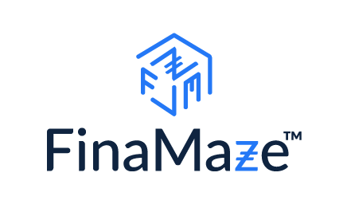
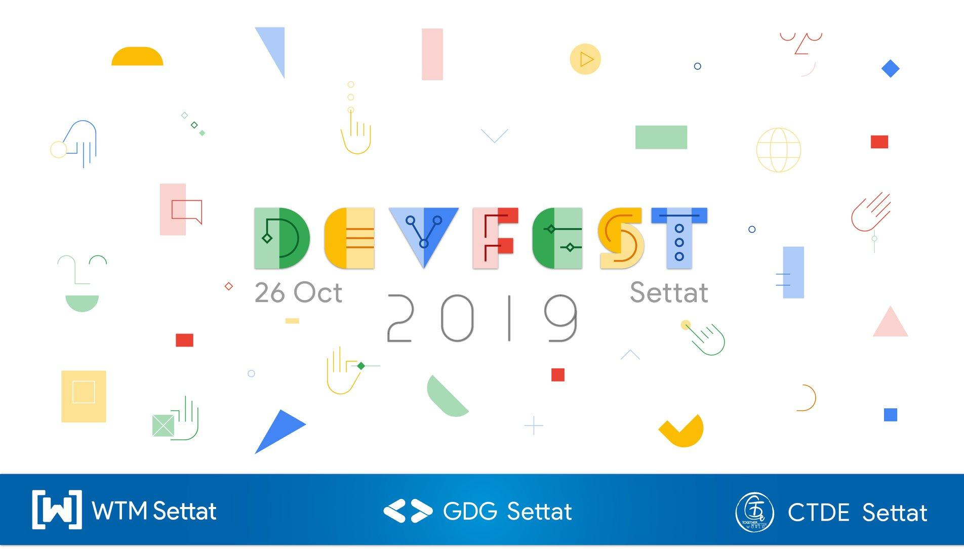

Applicative Data Science &
TensorFlow 2.0
@ sohayb-elamraoui

Slide 2


Plan:
Beyond “.fit()” Real challenges of Applicative Data Science
Mr/Ms. Perfect: The Data Scientist mentality
TensorFlow 2.0

Slide 3
The Real World:
Beyond “model.fit()”

Slide 4

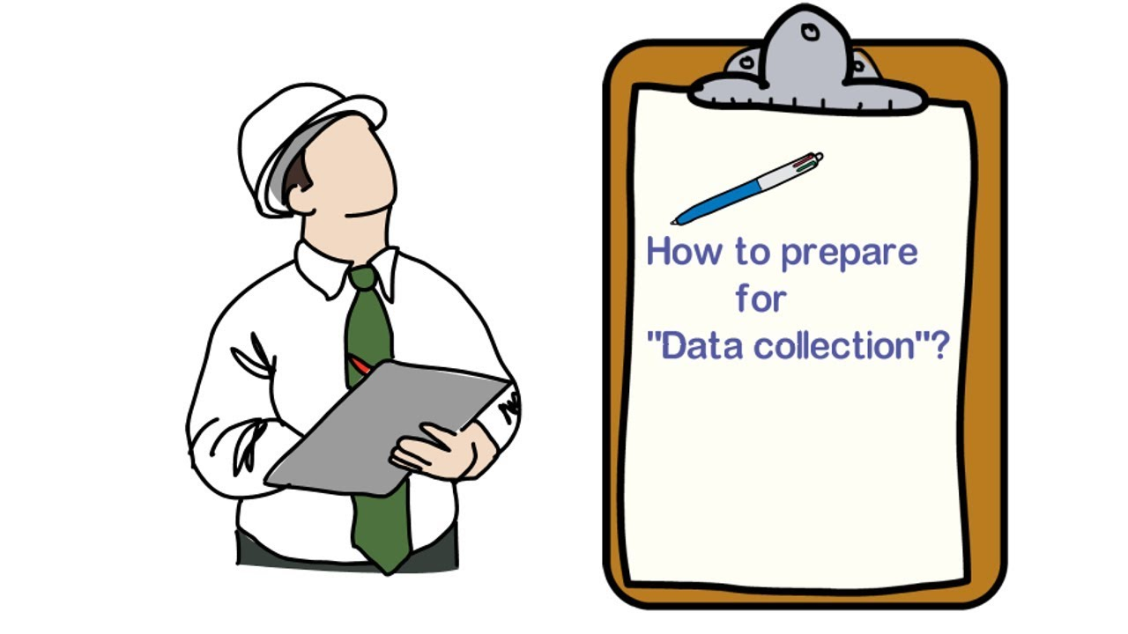
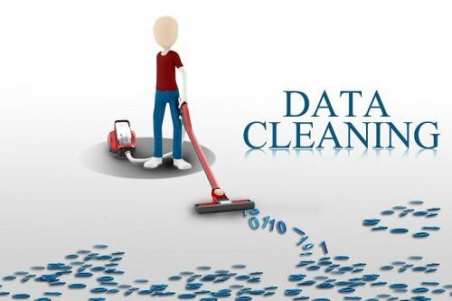
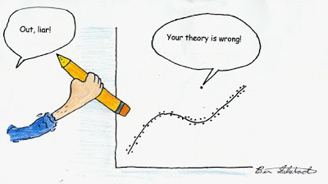
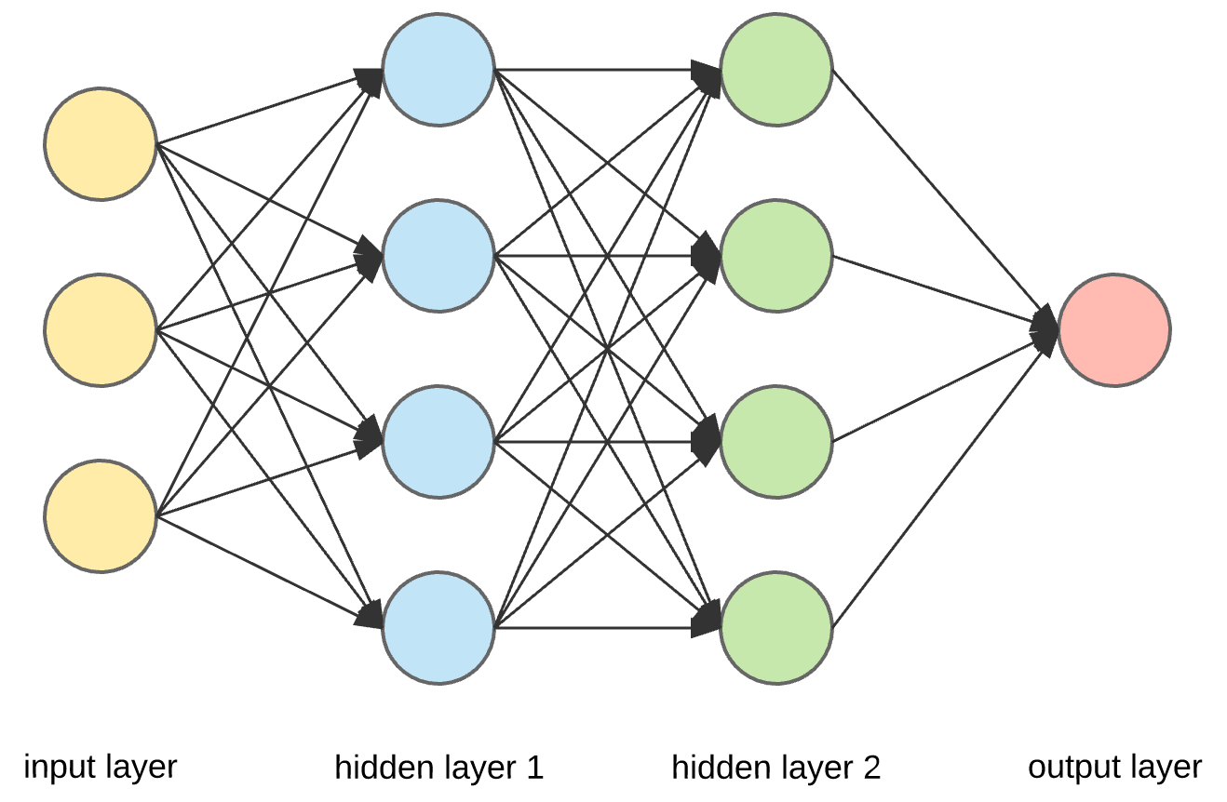
Doing Data Science
The usual
data
cycle

Slide 5
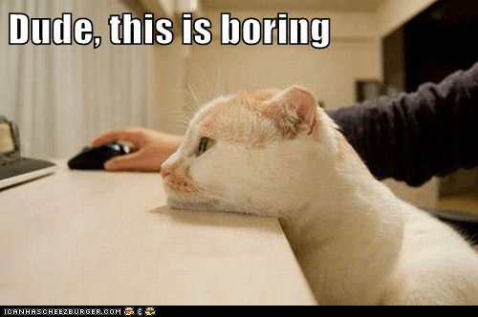
Data Collection / Annotation
Multi-step process: Collection and Annotation
Annotation is very expensive
Annotators need to be trained for a task
Annotating is a super laborious and boring task

Slide 6
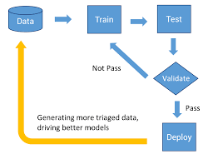
Modelling
Hardware dependency is real
Architecture constraints: Where are the model going to be deployed
A time Consuming Iterative process
Notes:
Choosing the right architecture is time consuming
Architecture selection is an iterative process and can take days/weeks

Slide 7
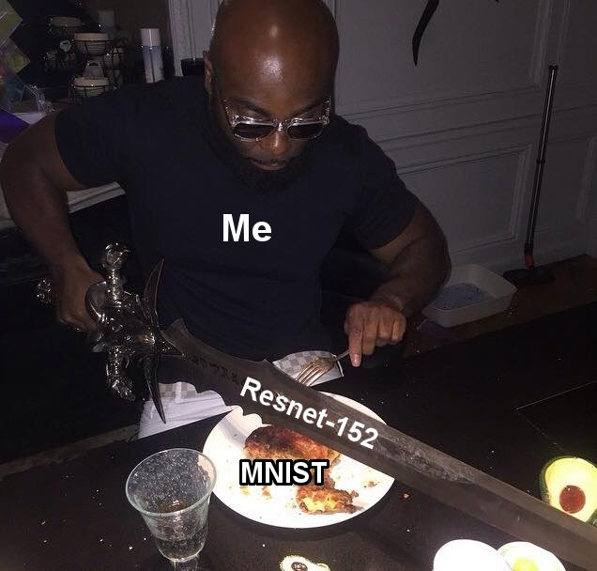
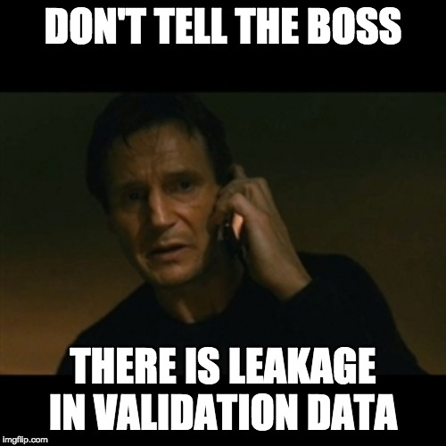
Newbie Mistakes

Slide 8
Do you think this is hard?
There is something that is even harder...

Slide 9
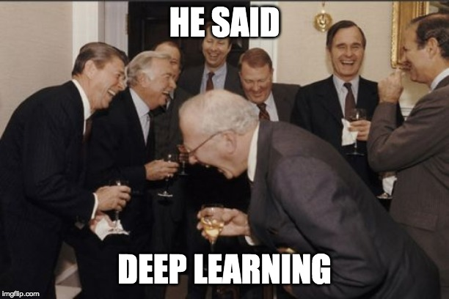
Business Constraints
Budget is what drives a project not your “cool” tech
Cost is usually high as it includes data cost, server cost, etc.
Timelines are hard to negotiate
90% accuracy is a Unicorn
Notes:
DL models are cool but do they justify business?
ML engineers aren’t cheap
may be a good number but business can scrape out the project as the numbers are low for them

Slide 10
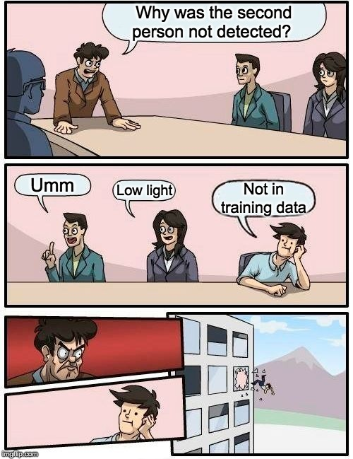
Model Explainability Matters
Business people have limited technical knowledge
No simple explanations to the question “Why the model behaved that way?”
If you can’t explain, you are already On the way out
Notes:
Class activation maps may be useful to you but for business people they doesn’t make sense at all.

Slide 11
The Right Mentality:
Mr./Ms. Prefect Data Scientist

Slide 12
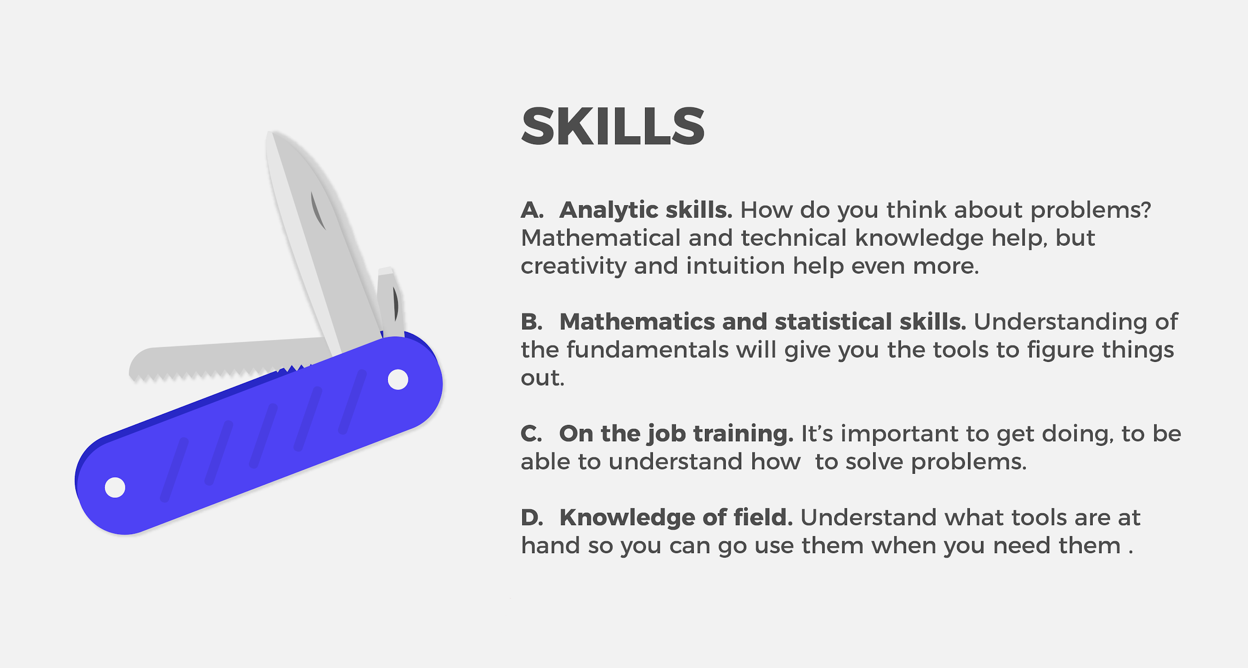

Slide 13
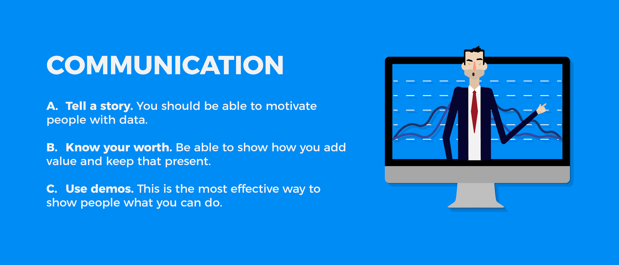

Slide 14
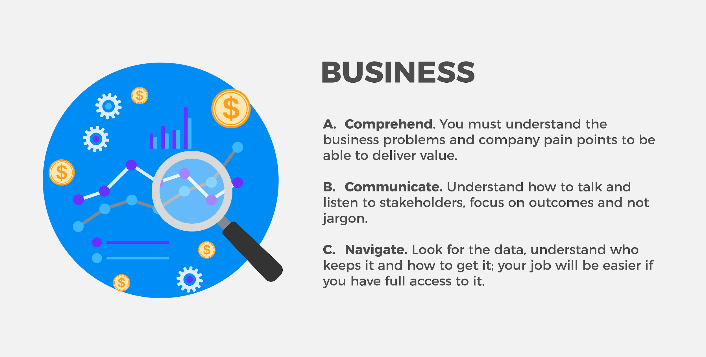

Slide 15
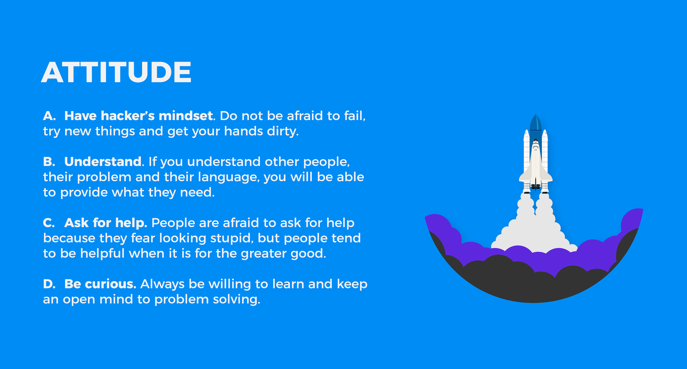

Slide 16
The Right Framework:
TensorFlow 2.0: what’s in it for you?

Slide 17
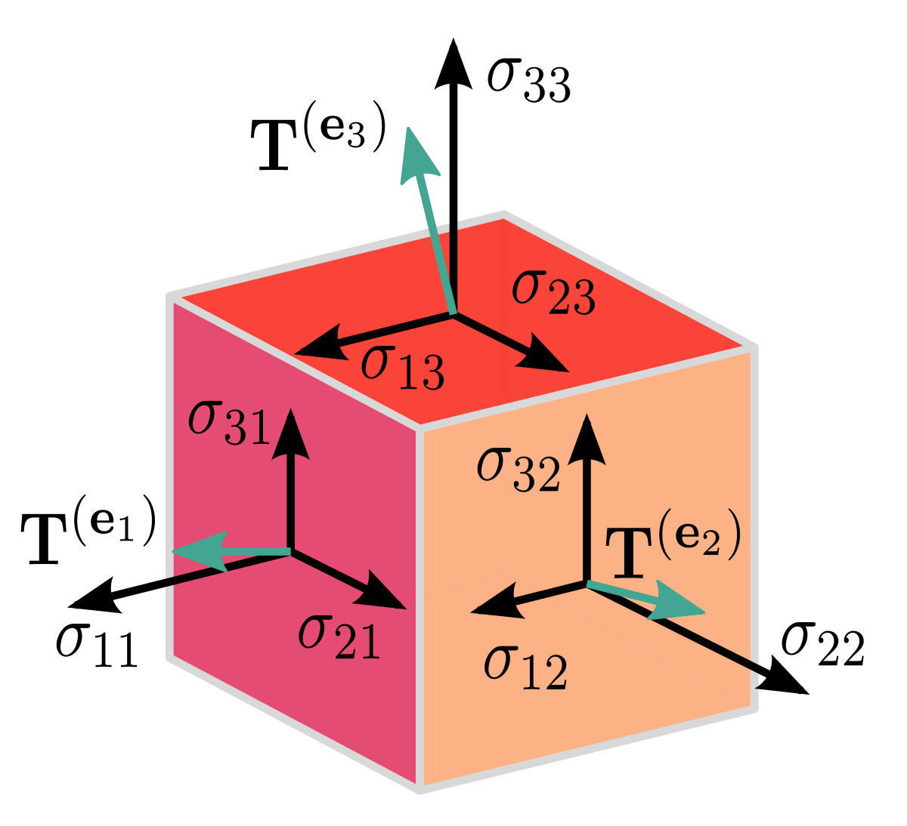
What’s Tensorflow
+

Slide 18
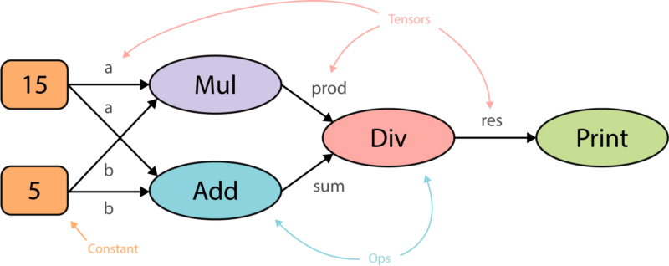
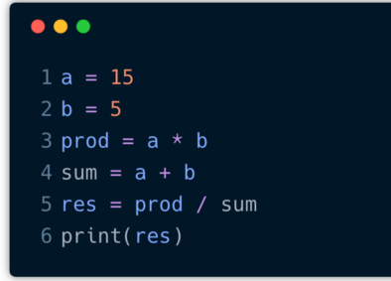
Graph Computation

Slide 19
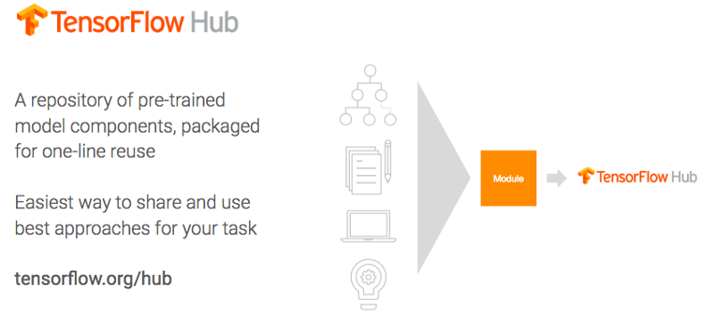
TF 2.0: Don’t Reinvent the Wheel

Slide 20
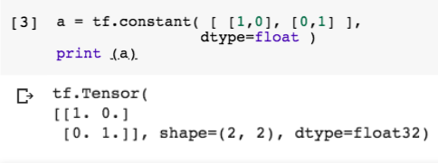
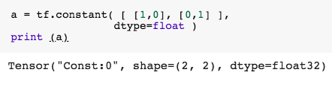
TF 2.0: More Pythonic
Notes:
Imperative
Define by run
No static Graphs or session
Faster Debugging and more dynamic control
Excution is very Tensorflow, but the debugging is more pythonic

Slide 21

TF 2.0: One Primary API, Tf.keras()

Slide 22
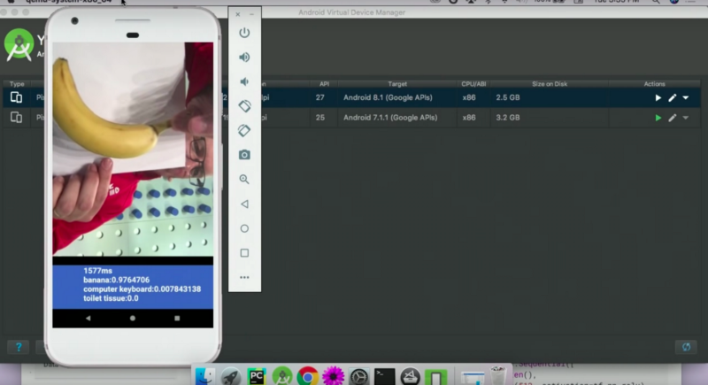
TF 2.0: the LIGHT version
Notes:
TensorFlow Lite brings model execution to a variety of devices, including mobile and IoT, giving you more than a 3x boost in inference speedup over original TensorFlow. Yes, now you can get machine learning on your Raspberry Pi or your phone

Slide 23
Q ＆ A ??
Notes:
Peresent the concepts that framed these applications

Slide 24
Thank you !!
Notes:
Peresent the concepts that framed these applications

